Slide 1
Power presentation on Language detection using nlp session 2022-23 (December)
Submitted By: Shubham Sharma
Guided By: Mr. Mario Thokchom

Slide 2
Introduction
Language detection is a natural language processing task where we need to identify the language of a text or document. Using machine learning for language identification was a difficult task a few years ago because there was not a lot of data on languages, but with the availability of data with ease, several powerful machine learning models are already available for language identification.

Slide 3
Language Detection
As a human, we can easily detect the languages we know. For example, I can easily identify Hindi and English, but being an Indian, it is also not possible for me to identify all Indian languages. This is where the language identification task can be used. Google Translate is one of the most popular language translators in the world which is used by so many people around the world. It also includes a machine learning model to detect languages that we can use if we don’t know which language you want to translate.

Slide 4
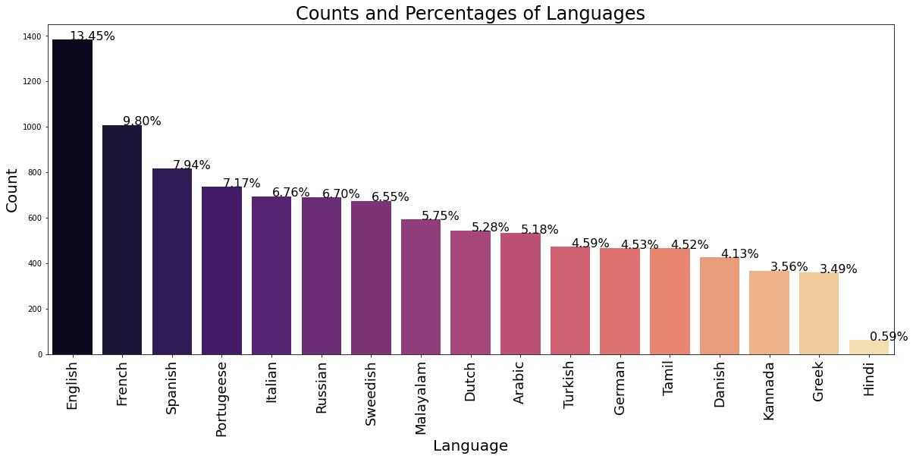
Visualization

Slide 5
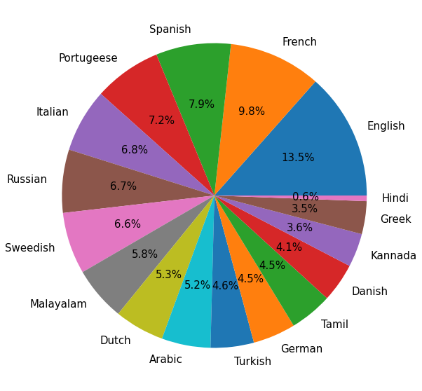

Slide 6
Label Encoding
Language names make up our output variable, which is a categorical variable. We are conducting label encoding on that output variable because we should need to turn it into a numerical form for training the model. We are importing LabelEncoder from sklearn for this procedure.

Slide 7
Bag of Words
As is common knowledge, both the input and the output features must be in numerical form. Therefore, using CountVectorizer to build a Bag of Words model, we are converting text into numerical form.

Slide 8
Building Model
For building model here we use three ml classification algorithms as KNN, Random Forest and Naïve Bayes. Naïve Bayes Classifier is one of the simple and most effective Classification algorithms which help in building the fast machine learning models that can make quick predictions.

Slide 9
Observations
Accuracy score: Accuracy score for the model KNN is very low 0.612. But for Random Forest and MNB accuracy score are quite good 0.953 and 0.986 respectively, so we choose MNB because it is fast and simple for NLP.

Slide 10
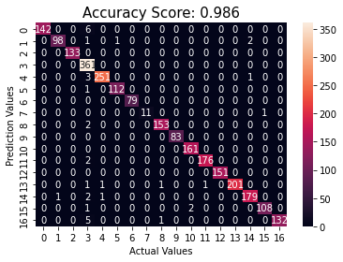
Confusion Matrix
Naive bayes:

Slide 11
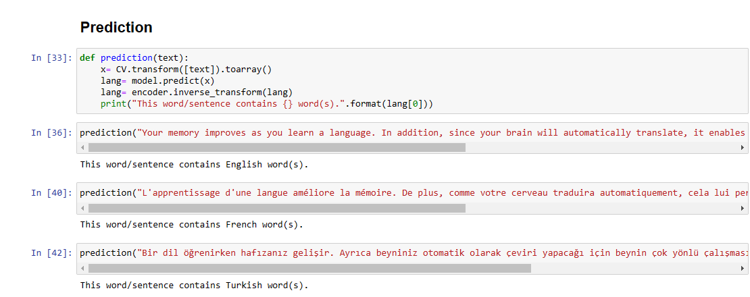
Prediction

Slide 12
Conclusion
In this project, we learned about the natural language processing in machine learning. We made the project on language detection by using different models like knn, random forest and naïve bayes. Naïve bayes model is found very accurate for this project as accuracy score is 0.986.

Slide 13
Thank you

